Slide 1
Victor Irekponor
Locally Weighted Correlation Coefficient (L.W.C.C)
4th November, 2022

Slide 2
Assumptions
Have some basic understanding of:
Correlation Coefficients
GWR

Slide 3
Problem
“Compare two datasets from different sources e.g Google street view images and census data”

Slide 4

Locally Weighted Correlation Coefficient
IDEA
For a global model, the coefficient for a single variable OLS == Pearson’s r (correlation coefficient) if you take out the intercept.
y = b_{o} + b₁x
y = b₁x because b_{o} (intercept) becomes 0 after standardizing
b₁ = r (correlation coefficient)
However, the same cannot be said for a local model. WHY?
Spatial weight matrix, W

Slide 5
What did we do?
Standardize the data after weighting
Modified the GWR code-base
gwr_results = GWR(g_coords, g_y, g_X, gwr_bw, constant=False, lwcc=True).fit()

Slide 6
Applications
Compare two datasets from different sources, that mean the same thing
For example – Variables generated from street view images to Variables from the national census dataset.

Slide 7
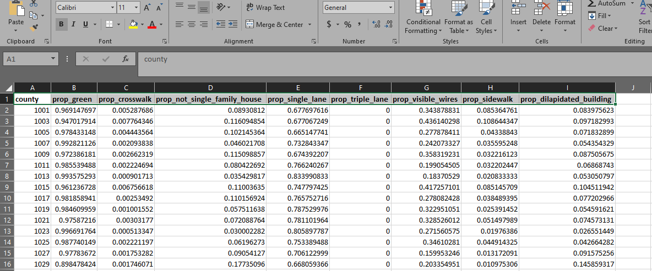
Dataset

Slide 8
How to generate indicators of built environment from census variables?

